Slide 1
Blockchains
405530008 姚馭博
405530027 郭鋒驛
405530038 陸柏宏

Slide 2
Categories
Introduction
Features
Security
Example
Question & Answers

Slide 3
Introduction
NOT a single innovation technology
Cryptography, Mathematics, Algorithm, Economic Model, and uses peer to peer Internet.
Base on the mathematic can establish trusts, and even don’t need the based on mutual trust.

Slide 4
Who throw the concept？
Satoshi Nakamoto is the creator of the Bitcoin agreement & associated software Bitcoin-Qt, but the true identity is unknown.
In 2008, published a paper “Bitcoin: A Peer-to-Peer Electronic Cash System” describes what he called “bits.” －Currency's electronic currency and its algorithm

Slide 5
Features
Decentralization
Openness
Self-governing
Tamper resistant
Time stamps

Slide 6
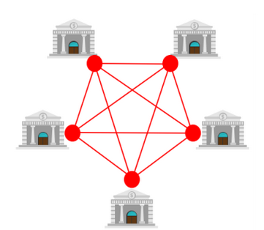
Decentralization
Distributed Architectures
Everyone is both communicator and verifier

Slide 7
Openness
Block Chain’s system is public
Data and source code is also in public
ONLY private in node’s private key

Slide 8
Self-governing
Rules
Freedom, Safety, Accessibility
Human-Human -> Human-Machine

Slide 9
Tamper resistant
Based on hash function & Asymmetric encryption
Information integrity

Slide 10
Time stamps
Stored all history data
Last part has the hash value from the front

Slide 11


Slide 12
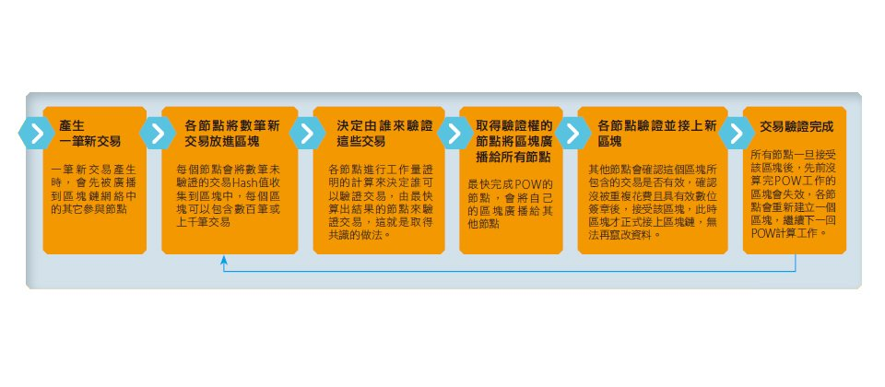
Transactions
Exchange occurred
All nodes take hash value in the block
Decide who to verify the transaction
Broadcasts the block to all nodes
Verify and chain the new block

Slide 13
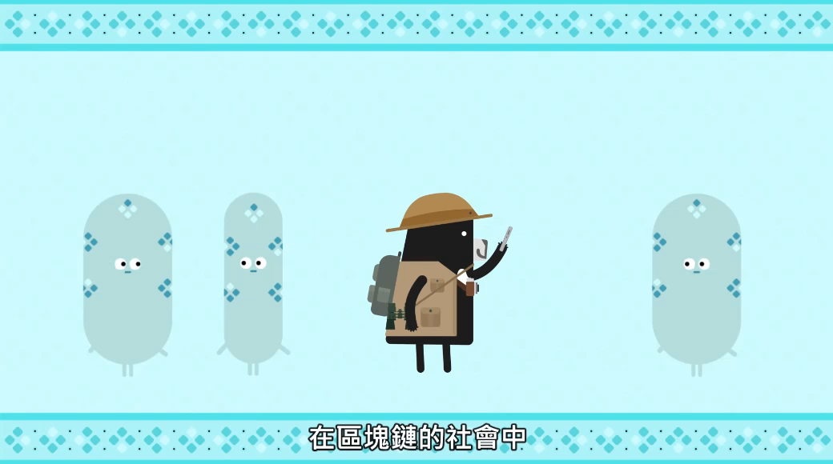

Slide 14
Reality example
Bitcoin *R = are *BC = Bitcoin
Blockchain : underlying technology of BC.
Decentralized openness allows everyone to freely purchase and sell.
Anonymity transactions & security of gold streaming data R foundation on which BC relies.
BC records transaction history in blockchain, blockchain will continue extended and interconnected, the new block won’t removed once.
BC’s transaction data needs validated after six blocks of verification, and disadvantage is : process is a bit slow

Slide 15
Block Chain Security
Hash uniqueness
Cryptographic security
Authentication
Decentralized distributed design
Transmission security

Slide 16
Hash uniqueness
Each block and hash is a one-to-one correspondence
Each hash is calculated from the block header by SHA256

Slide 17
Cryptographic Security
All data storage and records have digital signatures as credentials, asymmetric encryption guarantees the reliability of payments

Slide 18
Authentication
All data transfer will be verified
Find the last transaction to confirm the currency source
Calculate the fingerprint of the other party's public key and compare it with its address to ensure the authenticity of the public key
Unwrap digital signature using public key to ensure authenticity of private key

Slide 19
Decentralized distributed design
The current solution adopted by the blockchain is fully distributed storage. There are many full nodes in the network and all the book data are synchronized so that there are enough copies in the network to meet the high availability requirements. The risk of losing data will be low. a lot of.

Slide 20
Transmission security
In the process of transmission, data is processed using HTTP+SSL to ensure that data is protected from tampering and encryption during network transmission.

Slide 21
Question & Answer
What is the main feature of the block chain?
Decentralization
Block Chain is a single innovation technology (T/F)
F
What is the well known virtual currency apply on block chain?
Bitcoin

Slide 22
Reference
IThome
hbrTaiwan
Taiwan Bar
Template : FPPT.com

Slide 23
Thanks For Listening

